Slide 1



Beyond
Clean smarter, not harder

Slide 2
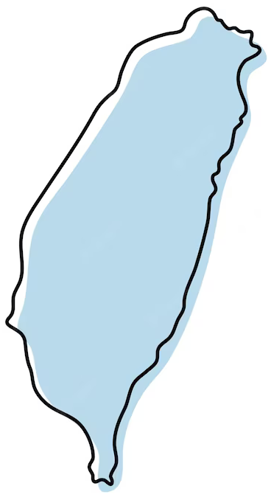
Did you know?
Garbage density reached 121,074 pieces in 2021
85% of plastic products end up in landfills
https://english.cw.com.tw/article/article.action?id=3040

Slide 3
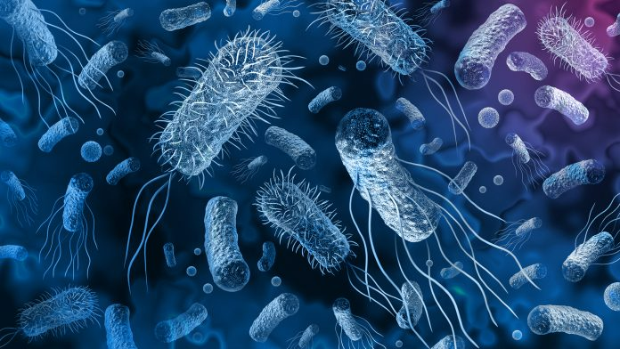
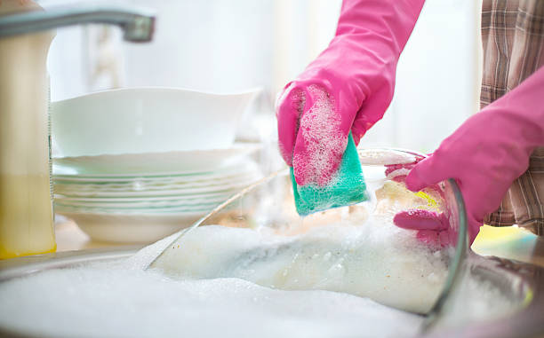

Slide 4
CommonWealth Magazine:
“More than 80% of Taiwanese shoppers were willing to spend more to buy sustainably produced goods.”
https://topics.amcham.com.tw/2021/08/taiwanese-buying-green-priority/

Slide 5
Cleaning products should also be cleaning the environment

Slide 6
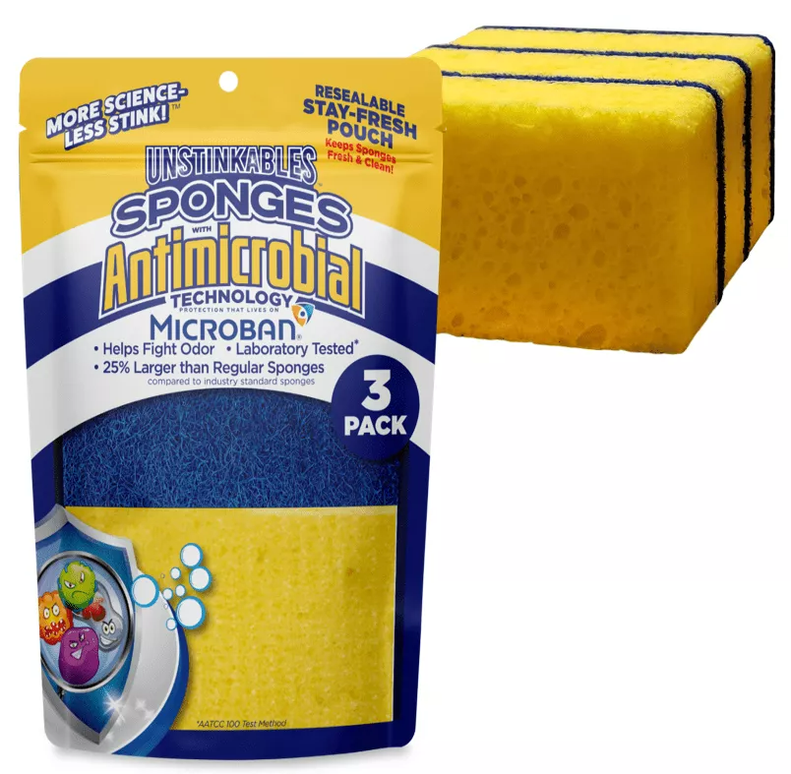
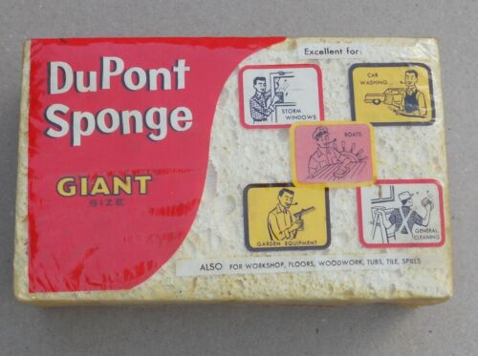
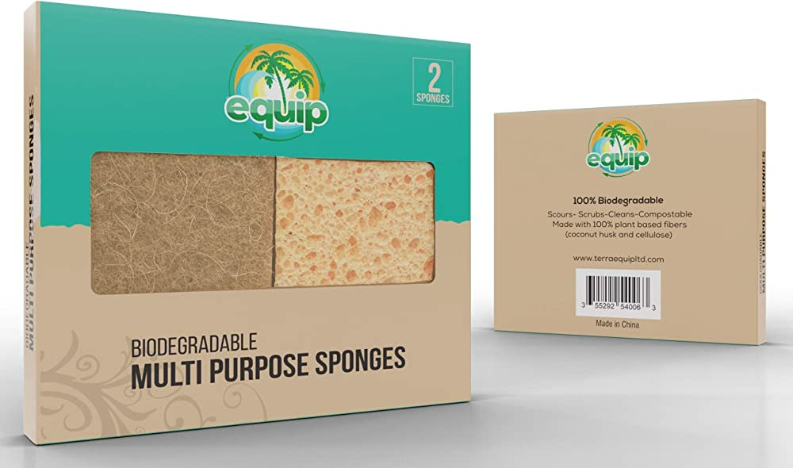
1920
1980
2000

Slide 7
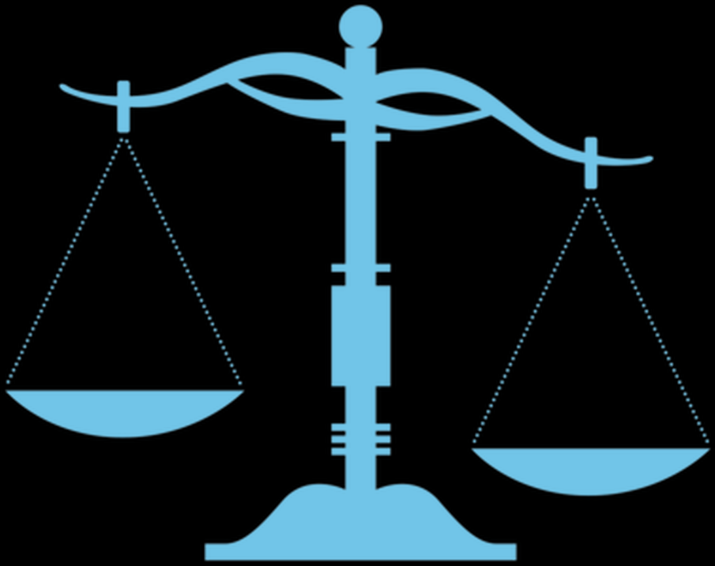
Features
and Benefits

Slide 8

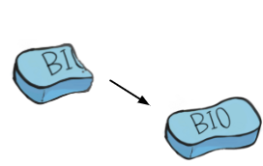
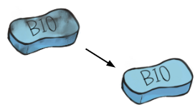
No need
cleaning liquid
Self-cleaning
Regeneration

Slide 9

Product Benefit table | Plastic sponge | Anti-bacteria Sponge | Eco-friendly fiber Sponge | Biotechnology Sponge
Environmentally friendly
Reusable
Versatility
Sustainability

Slide 10
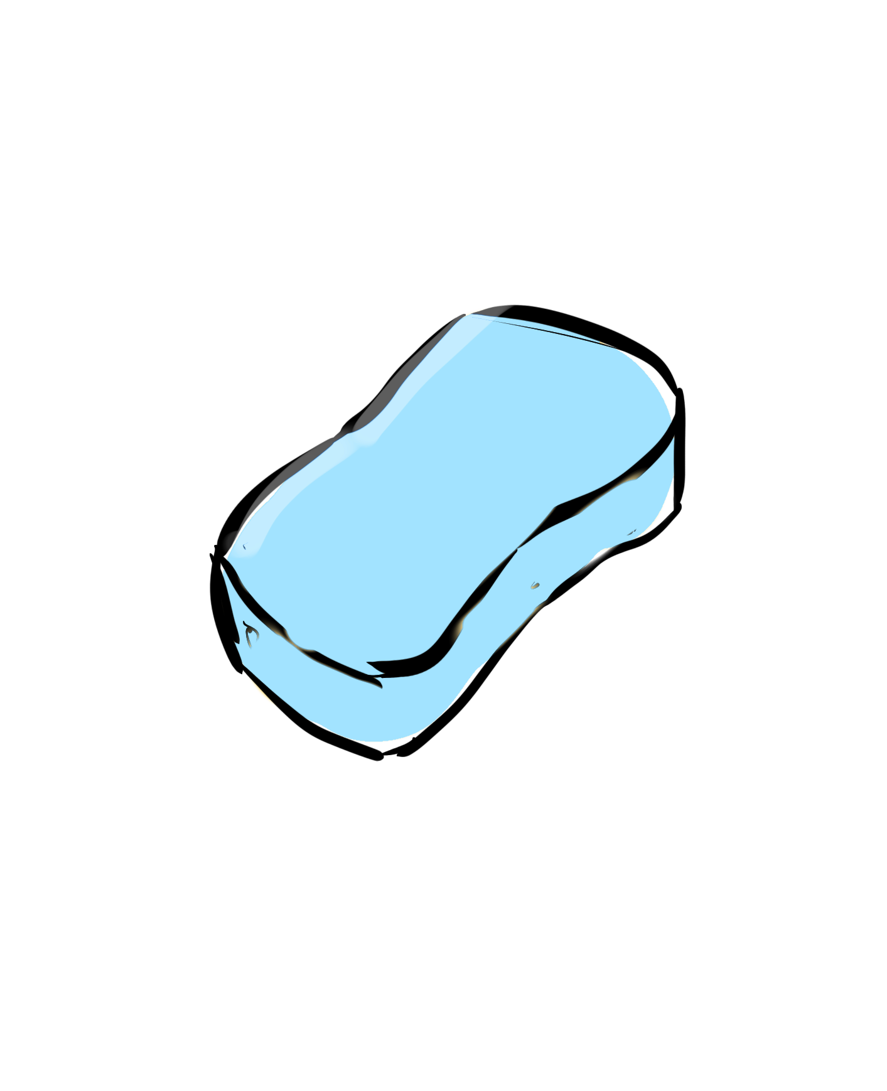
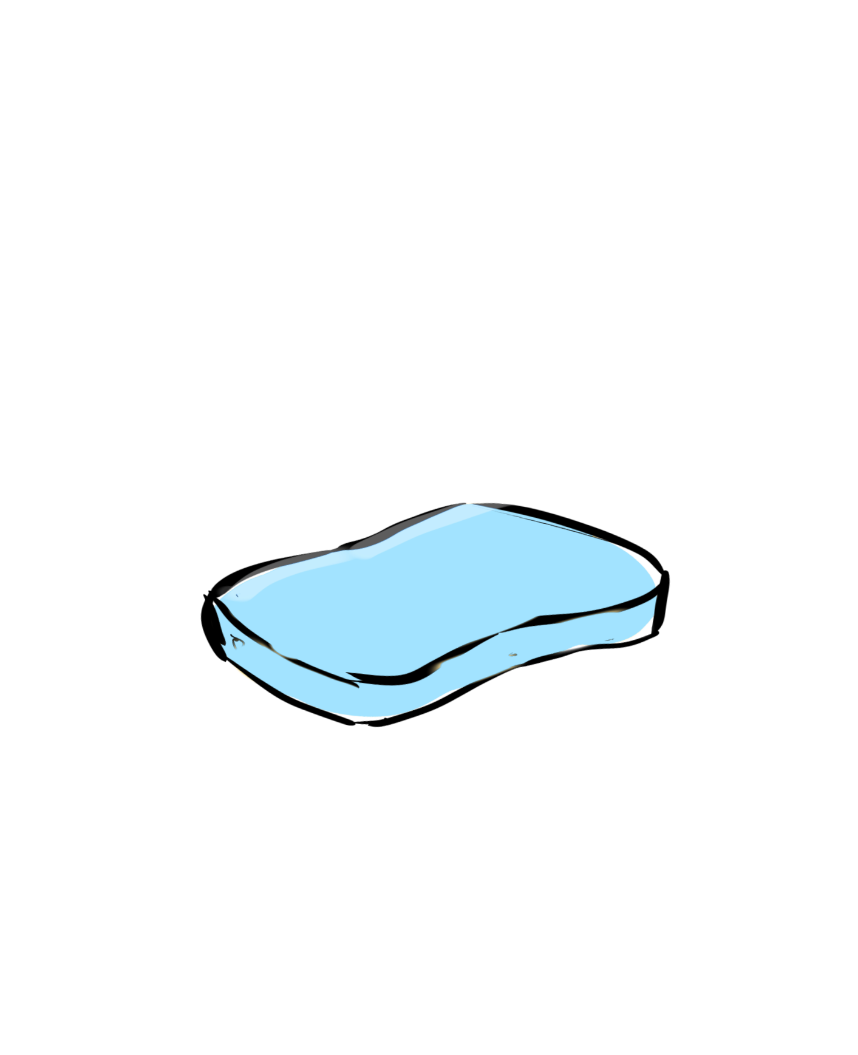
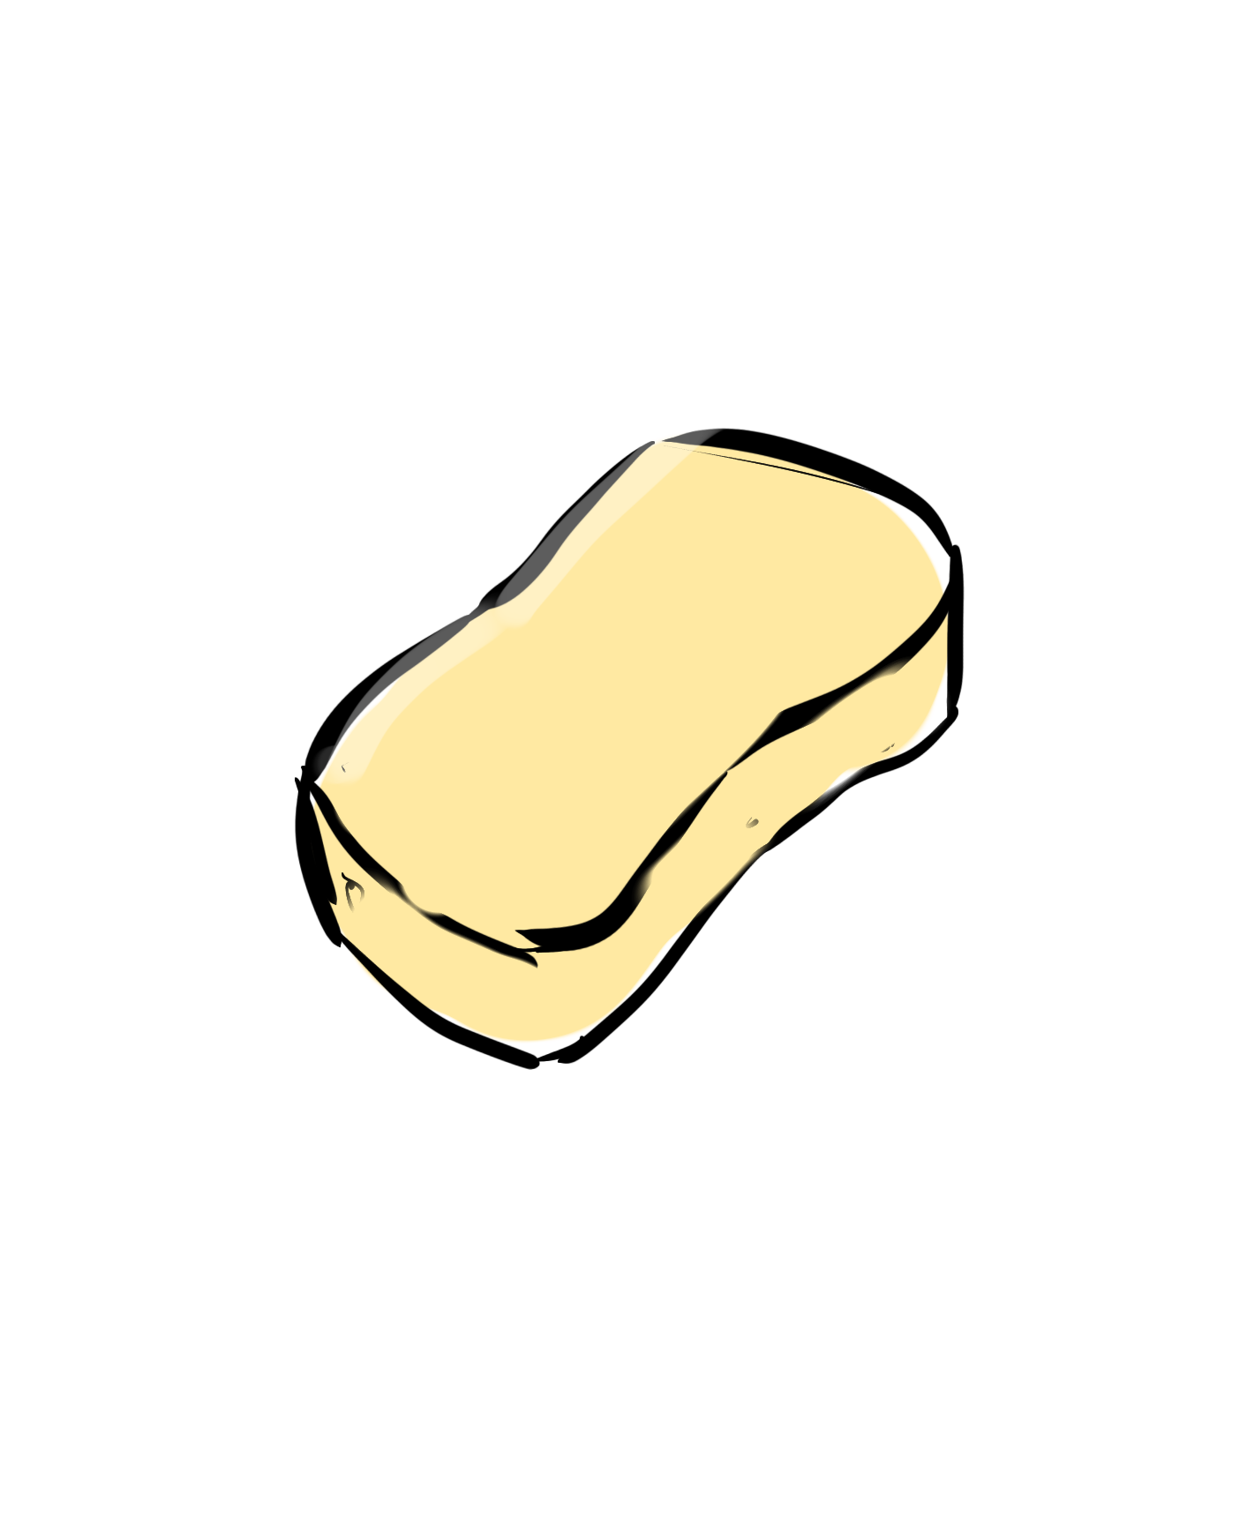
More of our products
Compressed version
General use
Kitchen version

Slide 11
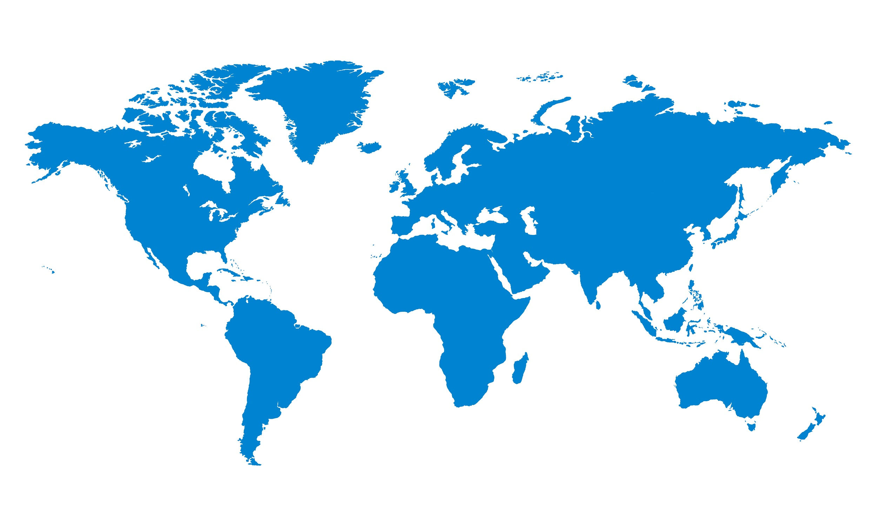

EPI ( Yae's Environmental Performance Index)

Slide 12
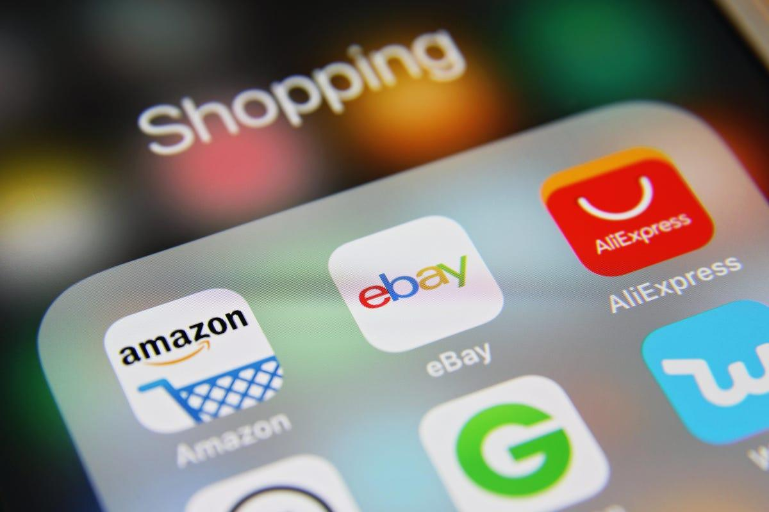
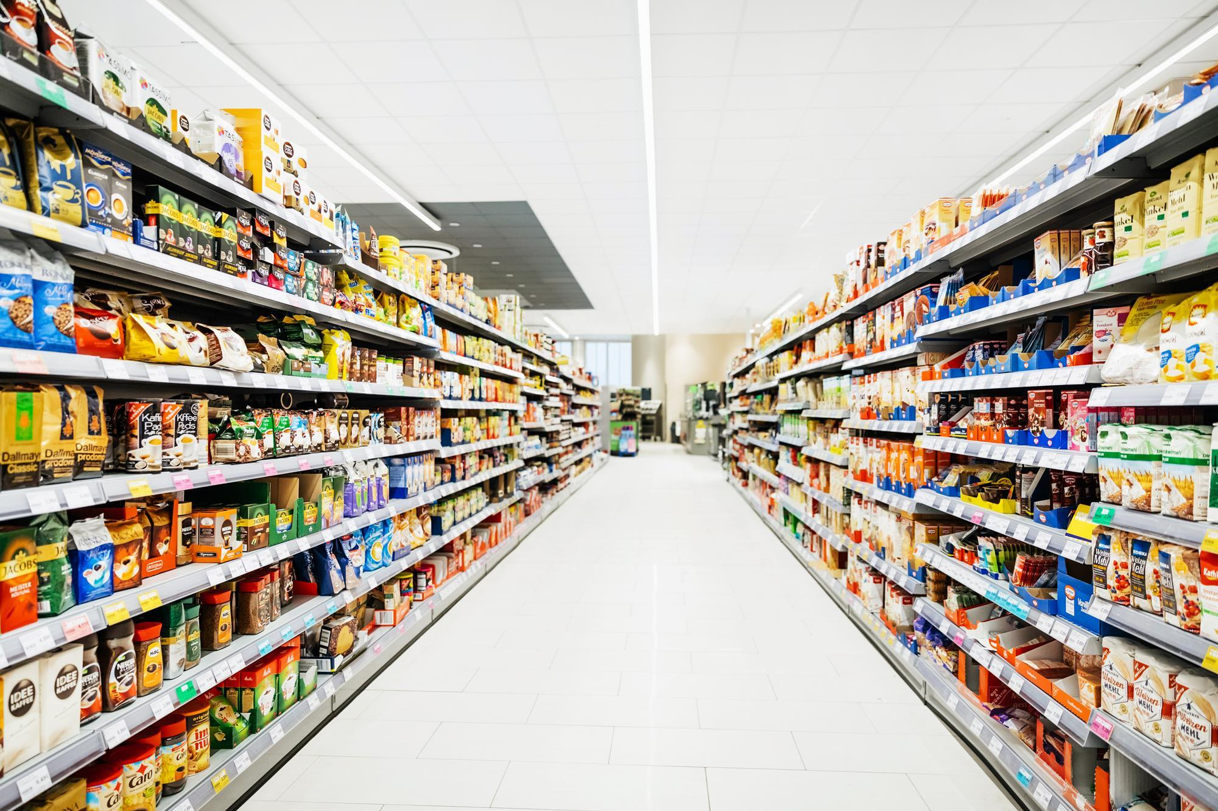
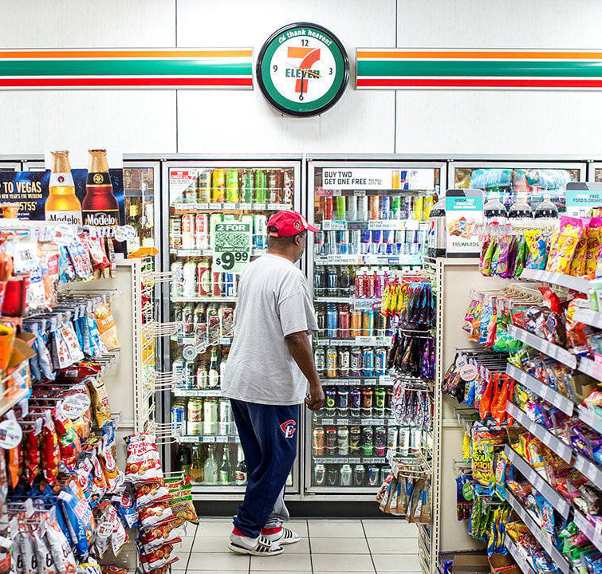
Available in all of these locations

Slide 13
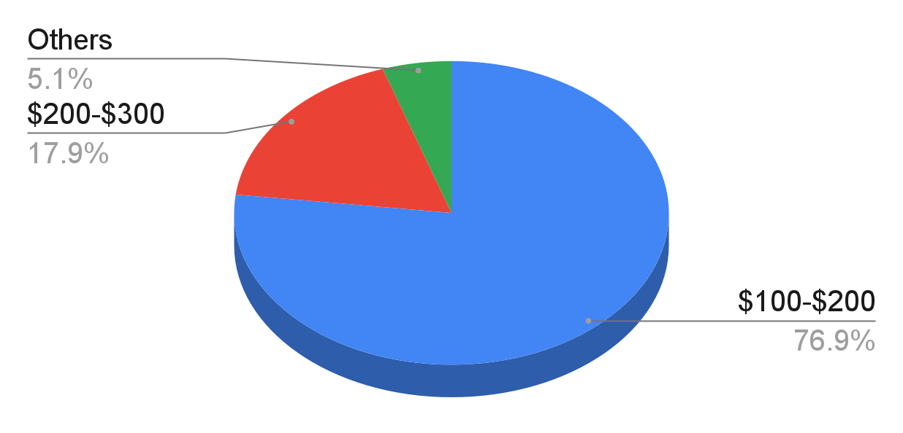
77% people are willing to pay a premium price
$149

Slide 14
1920
1980
2000

Slide 15

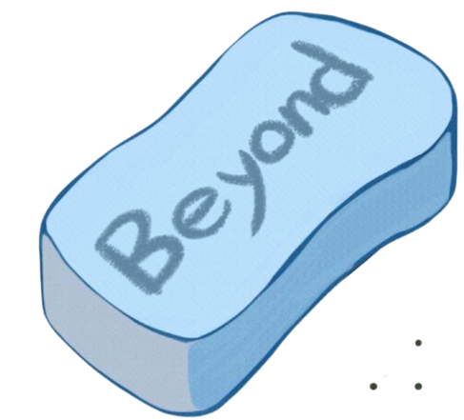
2023

Slide 16
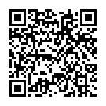
QR code
For more information…
Website link:
https://sites.google.com/view/beyondspongecom/%E9%A6%96%E9%A0%81?authuser=0

